Slide 1
Data Processing & Networking
Nahidul Islam
Lecturer, Dept. of CSE
Dhaka City College

Slide 2
Data
Data
Data refers to raw facts, figures, or symbols that, on their own, have no context or meaning. It can be quantitative (numbers, measurements) or qualitative (descriptive attributes).
Example: A list of temperatures recorded over a week, such as 70°F, 75°F, 68°F, etc.
Information
Information is data that has been processed, organized, or structured in a way that gives it meaning or context. It helps in decision-making and understanding.
Example: The average temperature for the week calculated from the data, which might inform you that it was a warm week overall.
Data Processing
Data processing is the process through which facts and figures are collected, assigned meaning, communicated to others and retained for future use. We can define data processing as series of actions or operations that converts data into useful information.

Slide 3
Types of Data
Data
Quantitative
Qualitative(Categorical)
Interval
Ratio
Discrete
Continuous
Nominal
Ordinal
Binary

Slide 4
Continue..
Type of Data | Description | Example
Quantitative Data | Numerical data that can be measured and counted. | Age, height, weight
Qualitative Data | Descriptive data that cannot be measured numerically. | Colors, names, labels
Discrete Data | Countable data that can take specific values. | Number of students in a class
Continuous Data | Data that can take any value within a range. | Temperature, time, distance
Nominal Data | Categorical data without a specific order. | Gender, blood type, city names
Ordinal Data | Categorical data with a specific order. | Satisfaction ratings (e.g., 1-5)
Interval Data | Numeric data with meaningful differences but no true zero. | Temperature in Celsius or Fahrenheit
Ratio Data | Numeric data with meaningful differences and a true zero. | Weight, height, income

Slide 5
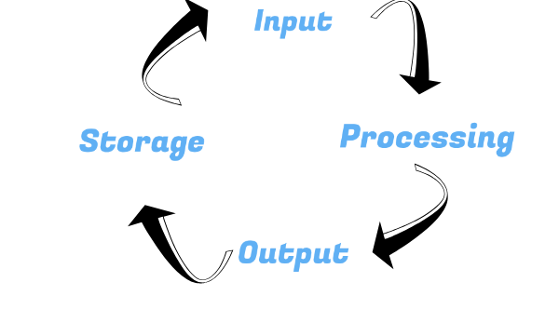
Data Processing Cycle
1. Input: The first step involves collecting raw data from various sources. This data can be in various forms, such as text, numbers, images, or sensor readings.
Entering data through keyboards, scanners, or sensors.
2. Process: In this step, the raw data is manipulated and processed to convert it into useful information. This may involve organizing, calculating, comparing, or analyzing the data.
Performing calculations (e.g., summing numbers, averaging).
3. Output: The processed data is then presented in a meaningful format. This output can take various forms, such as reports, graphs, charts, or dashboards.
Displaying data visualizations like pie charts or bar graphs.
4. Storage: Finally, the processed data and outputs are stored for future use. This ensures data is preserved and can be retrieved when needed.
Saving data in databases, cloud storage, or local file systems.

Slide 6
Data Processing Application in Business
Process Control:
Process control involves real-time monitoring and regulation of processes, particularly in manufacturing and industrial operations. Data from sensors and machinery are collected, processed, and used to automatically adjust variables like temperature, pressure, and speed. Businesses use data processing for:
Automation: Reducing human intervention by automating repetitive tasks.
Efficiency: Ensuring that machinery operates optimally.
Quality control: Monitoring data for deviations to maintain product quality.
Accounting:
Accounting systems process financial transactions such as sales, purchases, payments, and receipts. Data processing in accounting helps businesses in:
Financial reporting: Generating income statements, balance sheets, and cash flow statements.
Auditing: Ensuring that financial records are accurate and compliant with regulations.
Budgeting: Analyzing financial data to create budgets and forecasts.

Slide 7
Continue..
Payroll Preparation:
Payroll systems automate the process of paying employees, including calculating wages, withholding taxes, and managing deductions. Data processing in payroll includes:
Compensation calculations: Processing data related to hours worked, salary, and bonuses.
Tax compliance: Automatically calculating and withholding the correct tax amounts.
Record keeping: Storing employee payroll history for future reference and audits.
Sales Analysis:
Sales analysis systems process sales data to provide insights into customer behavior, market trends, and product performance. Businesses use this data for:
Revenue tracking: Analyzing sales performance over time.
Customer segmentation: Identifying different customer groups and their preferences.
Sales forecasting: Predicting future sales based on historical data

Slide 8
Continue..
Inventory Management:
Inventory management systems process data about stock levels, orders, and deliveries. This helps businesses manage supply chains efficiently. Key data processing tasks include:
Stock tracking: Monitoring current inventory levels.
Reordering: Automating reordering when stock levels fall below a certain threshold.
Demand prediction: Analyzing sales data to forecast future stock needs.
Office Automation:
Office automation involves using software to handle routine office tasks such as document processing, scheduling, and communication. Data processing applications in this area include:
Document management: Organizing and storing business documents digitally.
Email management: Automating email sorting and responses.
Task scheduling: Processing data to manage calendars and task lists.

Slide 9
Continue..
Banking and Insurance:
Banking and insurance industries rely heavily on data processing to manage large volumes of transactions and customer information. Applications include:
Transaction processing: Handling deposits, withdrawals, and transfers in real-time.
Risk analysis: Using customer data to assess risk for loans and insurance policies.
Fraud detection: Analyzing transaction patterns to detect suspicious activities.
Insurance and Stock Broking:
In insurance, data processing helps in policy management, claims processing, and customer service. Stockbroking firms use data to process trades, manage portfolios, and assess market trends:
Policy management: Handling customer data to create, update, and manage insurance policies.
Claims processing: Automating the validation and payout of insurance claims.
Trade processing: Recording and settling stock trades in real-time

Slide 10
Data Processing Operations
Input Operations: Input operations are the processes where raw data is fed into a system for processing. This can be done manually (e.g., typing on a keyboard) or automatically (e.g., data sensors or batch file uploads).
Examples of Input Devices:
Keyboard: For entering text or commands.
Mouse: For selecting or navigating interfaces.
Output Operations: Output operations produce processed data in a format understandable to users. This can include visual display (monitor), physical printouts, or stored digital formats (files).
Examples of Output Devices:
Monitor: Displays graphical or textual data.
Printer: Produces hard copies of documents or images.

Slide 11
Calculation and Text Manipulation
This category of data processing focuses on modifying, calculating, or transforming data into meaningful results. This is where the actual "processing" happens.
Calculation Operations: These operations involve performing arithmetic or logical operations on numerical data. Calculation operations are often necessary for tasks like budgeting, scientific computing, accounting, and business analytics.
Arithmetic Calculations: Basic operations such as addition, subtraction, multiplication, and division (e.g., calculating sales totals, generating invoices).
Text Manipulation Operations: Text manipulation involves modifying, formatting, or analyzing text data. This includes tasks such as string matching, formatting, text parsing, and restructuring data.
Changing the style, size, or arrangement of text (e.g., turning lowercase text into uppercase).

Slide 12
Storage and Retrieval Operations
Storage and retrieval are critical data processing operations that deal with saving data and accessing it for later use.
Storage Operations: Storage operations involve writing or saving data to a storage medium (e.g., a hard drive, database, or cloud service) so that it can be accessed later.
Temporary Storage (RAM): Used for storing data temporarily while a system is powered on. Once the system shuts down, the data is lost.
Persistent Storage (Hard Drives, SSDs, Cloud Storage): Stores data permanently or semi-permanently. Data remains even after power is turned off, ensuring long-term availability.
Retrieval Operations: Retrieval operations involve fetching or reading stored data for use in further processing, display, or analysis. Data retrieval can be simple or complex, depending on how data is organized and indexed.
File Retrieval: Simple retrieval of files or documents from storage media (e.g., opening a file from a hard drive).
Database Queries: More complex data retrieval using languages like SQL to fetch specific records from databases (e.g., retrieving all customers from a particular city).

Slide 13
Computer Network
A computer network is a collection of interconnected devices, such as computers, servers, smartphones, and peripherals, that can communicate and share resources with each other. These devices are linked together using various communication mediums, like cables (e.g., Ethernet, fiber optic) or wireless technologies (e.g., Wi-Fi, Bluetooth). The purpose of a network is to enable the efficient exchange of data and information, facilitating collaboration, resource sharing, and communication.
Types of Network Communication:
Sender: The sender is the originating point of a message or data transmission. It can be any device or application capable of transmitting data over a network.
A computer sending an email.
Receiver: The receiver is the destination point for a message or data transmission. It's the device or application that receives the data sent by the sender. Examples include:
A computer receiving an email.

Slide 14
Continue…
Data: Data is the information being transmitted between the sender and the receiver. It can take many forms, including:
Text files
Images
Videos
Medium: The medium is the physical or wireless pathway through which data travels from the sender to the receiver. It's the channel that carries the data signals. Examples include:
Wired Media:
Twisted Pair Cables (e.g., Ethernet cables): Commonly used for LAN connections.
Coaxial Cables: Used for cable television and some network connections.
Fiber Optic Cables: Transmit data as light pulses, offering high bandwidth and long-distance transmission.
Wireless Media:
Radio Waves: Used for Wi-Fi, Bluetooth, and cellular communication.
Microwaves: Used for satellite communication and point-to-point links.
Infrared: Used for short-range communication between devices.
Internet Connectivity: Internet connectivity refers to the ability of a device or network to connect to the Internet. The Internet is a global network of networks, connecting billions of devices worldwide.

Slide 15
Types of Network
PAN(Personal Area Network): is a network for connecting devices within the range of an individual person, typically within a few meters. e.g., Bluetooth, hotspot.
LAN (Local Area Network): Connects devices in a limited area (home, office, school). Think of your home Wi-Fi network connecting your computers, phones, and smart TV. High speed, low cost, easy to manage.
MAN (Metropolitan Area Network): Connects devices across a larger area, such as a city. A university campus network spanning multiple buildings, or a network connecting several bank branches in a city, would be examples. Larger than a LAN, smaller than a WAN.
WAN (Wide Area Network): Connects devices over a vast geographical area, like a country or the world. The internet is the prime example; it connects networks globally. Generally slower and more expensive than LANs and MANs.

Slide 16
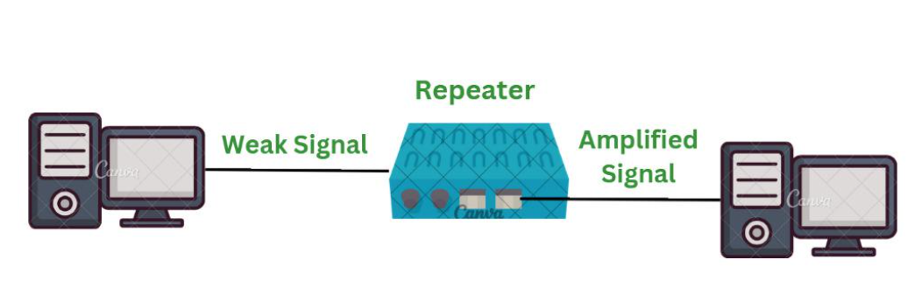
Network Hardware Components
Repeaters are defined as a networking device that is used to amplify and generate the incoming signal. Repeaters work at the physical layer of the OSI model. The main aim of using a repeater is to increase the networking distance by increasing the strength and quality of signals.

Slide 17
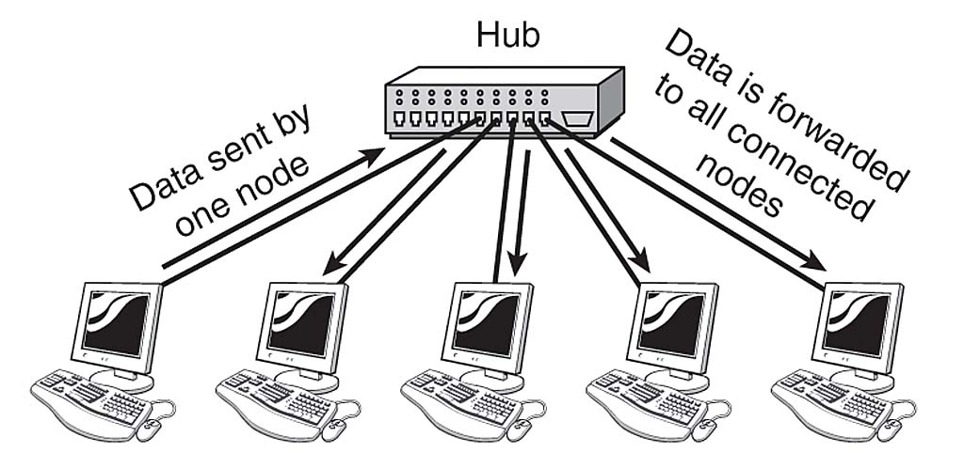
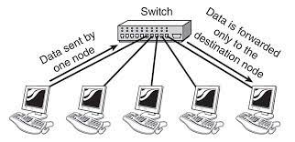
Continue…
Hub in networking plays a vital role in data transmission and broadcasting. A hub is a hardware device used at the physical layer to connect multiple devices in the network. Hubs are widely used to connect LANs. A hub has multiple ports. Unlike a switch, a hub cannot filter the data, i.e. it cannot identify the destination of the packet, So it broadcasts or sends the message to each port.
When the source wants to send the data packet to the destination, the packet first enters the switch and the switch reads its header and finds the MAC address of the destination to identify the device then it sends the packet out through the appropriate ports that lead to the destination devices.

Slide 18
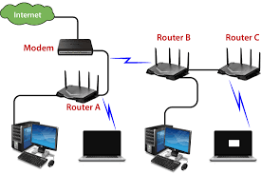
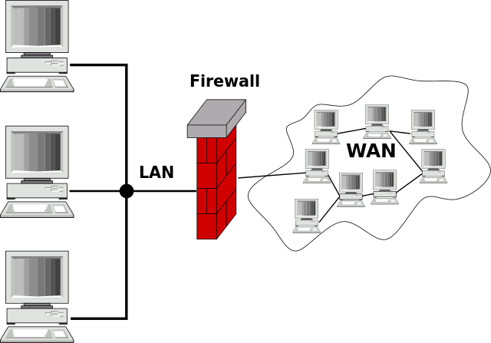
Continue…
A Router is a networking device that forwards data packets between computer networks. By sending data packets to their intended IP addresses, it manages traffic between different networks and permits several devices to share an Internet connection.
A firewall is a network security device, either hardware or software-based, which monitors all incoming and outgoing traffic and based on a defined set of security rules accepts, rejects, or drops that specific traffic.
Accept: allow the traffic
Reject: block the traffic but reply with an “unreachable error”
Drop: block the traffic with no reply

Slide 19
Topology
Network topology refers to the physical or logical arrangement of nodes and connections in a network. It describes how devices (like computers, routers, switches) are interconnected and communicate with each other.
Types of Topology:
Bus
Mesh
Star
Ring
Tree
Hybrid

Slide 20
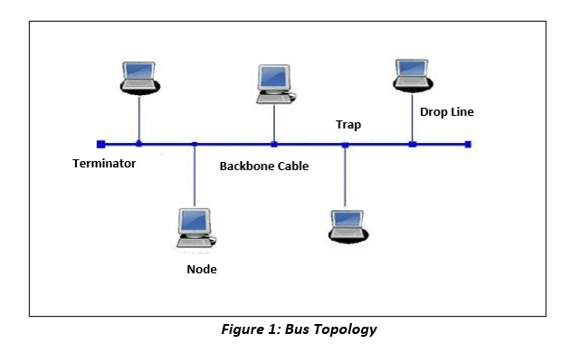
Bus
Bus topology is one of the simplest forms of network design and is widely used in small, local area networks (LANs). In this topology, all the devices (or nodes) in the network are connected to a single central cable known as the bus or backbone.
Key Features of Bus Topology:
Single Cable Backbone
Bidirectional Communication
Termination
Advantages of Bus Topology:
Simplicity and Cost-Effectiveness
Works Well in Small Networks
Easy to Extend
Minimal Cable Requirement
Disadvantages of Bus Topology:
Difficult to Troubleshoot
Collisions
Decreased Performance with Heavy Traffic
Dependency on Terminators

Slide 21
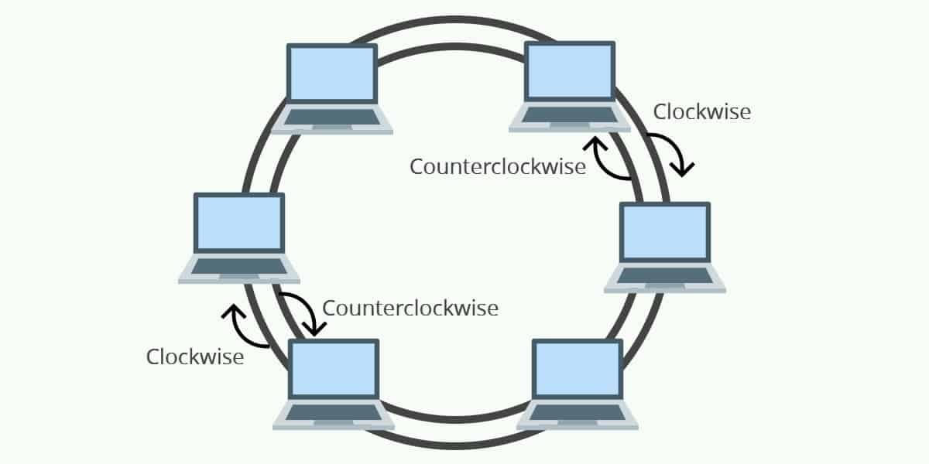
Ring
In a Ring Topology, all devices (also called nodes) are connected in a circular manner, forming a closed loop or ring. Each device is connected to exactly two other devices, one on each side, creating a unidirectional or bidirectional path for data to flow. Data travels in one direction (unidirectional) or both directions (bidirectional), passing through each device until it reaches its intended destination.
Advantages of Ring Topology:
Organized Data Transmission
Equal Access
Scalability
Reduced Collisions
Disadvantages of Ring Topology:
Single Point of Failure (Unidirectional Ring):
Latency
Difficult Troubleshooting
High Maintenance
Performance Degradation

Slide 22
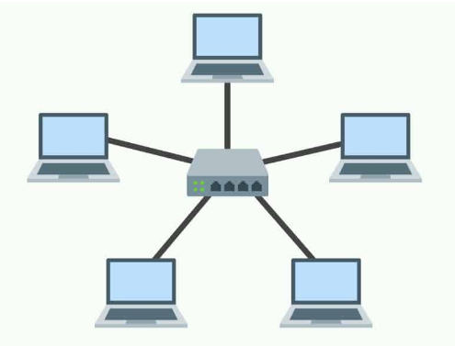
Star
Star topology is one of the most commonly used network topologies in modern networking. In this topology, all devices (also called nodes) are connected to a central device, typically a hub, switch, or router, forming a star-like pattern. Each node (e.g., computers, printers) has its own dedicated cable connecting it to the central device. This central hub acts as a communication mediator between the nodes.
Advantages of Star Topology:
Easy to Set Up and Manage:
Centralized Control
Isolation of Devices
Easy to Troubleshoot
Scalability
Efficient Data Handling
Disadvantages of Star Topology:
Central Point of Failure
High Cable Cost
Limited Cable Length
Performance Bottleneck

Slide 23
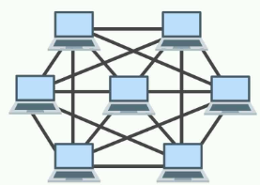
Mesh
Mesh topology is a type of network arrangement where each device (also called a node) is connected to every other node in the network. This structure provides a highly reliable and fault-tolerant system, making it an excellent choice for networks that require high availability, such as in critical applications like data centers, military communication systems, and advanced enterprise networks.
Advantages of Mesh Topology
High Reliability
Scalability
Robust Data Transmission
Load Balancing
Disadvantages of Mesh Topology
High Cost:
Complex Installation and Configuration:
Difficult to Manage:
Inefficient for Small Networks

Slide 24
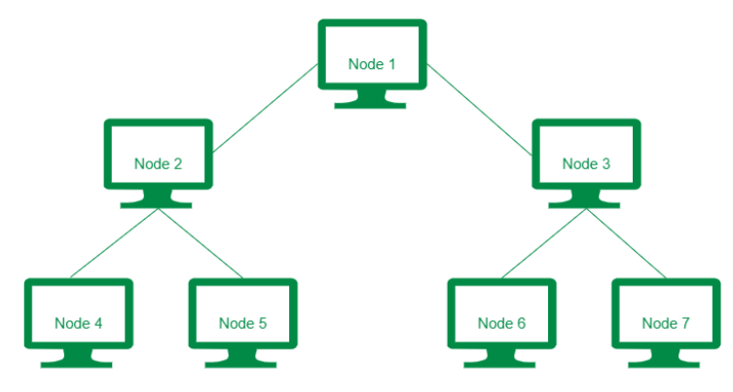
Tree
Tree topology, also known as a hierarchical topology, is a network structure that combines elements of both the bus and star topologies. It is one of the most commonly used network topologies, especially in large networks like corporate or educational campuses, where hierarchical relationships among devices or groups of devices are needed.
Advantages of Tree Topology:
Scalability
Hierarchy and Grouping
Fault Isolation
Ease of Maintenance
Effective for Large Networks
Disadvantages of Tree Topology:
Dependence on Backbone
Complexity
Cost
Maintenance Challenges
Propagation Delay

Slide 25
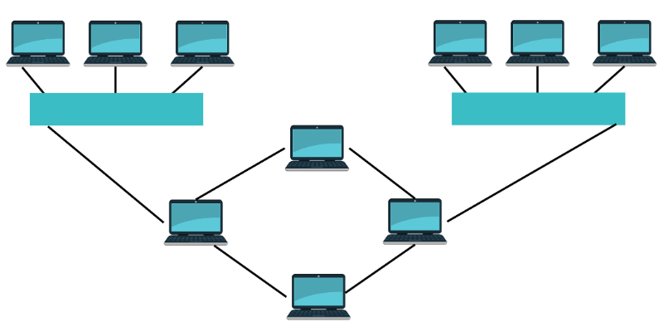
Hybrid
A Hybrid Topology is a network topology that combines two or more different types of standard network topologies to meet specific needs. It is designed to leverage the strengths of the combined topologies while minimizing their weaknesses. The hybrid approach is flexible and scalable, making it suitable for larger, more complex networks, such as those found in corporate or enterprise environments.
Advantages of Hybrid Topology
Flexibility
Scalability
Efficient Performance
Fault Tolerance and Reliability
Cost-Effective Design
Disadvantages of Hybrid Topology
Complexity
Cost of Setup
Integration and Compatibility Issues
Maintenance

Slide 26
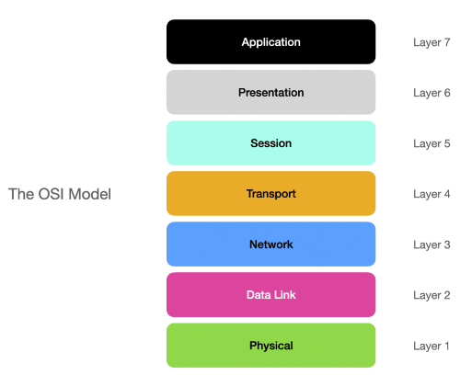
OIS(Open Systems Interconnection) Model
The OSI Model (Open Systems Interconnection Model) is a conceptual framework used to understand and standardize the functions of a networking system. It breaks down the process of communication between two networked systems into seven distinct layers, with each layer having a specific function. Developed by the International Organization for Standardization (ISO) in 1984, the OSI model helps different hardware and software systems to communicate with one another across different vendors and platforms.

Slide 27
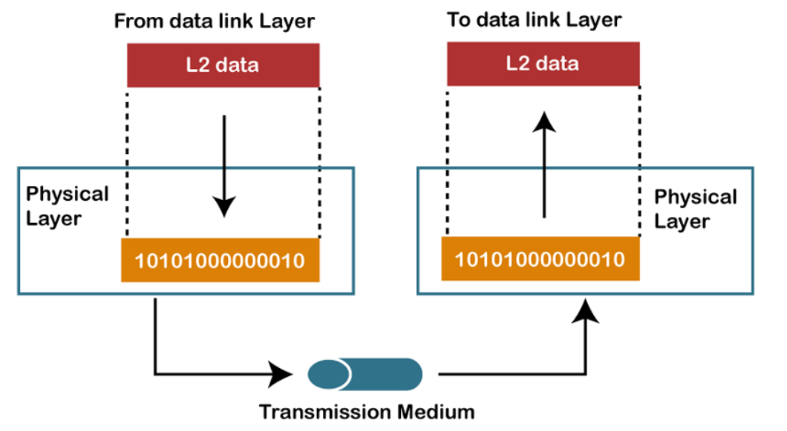
Physical Layer
The lowest layer of the OSI reference model is the physical layer. It is responsible for the actual physical connection between the devices. The physical layer contains information in the form of bits. It is responsible for transmitting individual bits from one node to the next. When receiving data, this layer will get the signal received and convert it into 0s and 1s and send them to the Data Link layer.
Hub, Repeater, Modem, and Cables are Physical Layer devices.

Slide 28
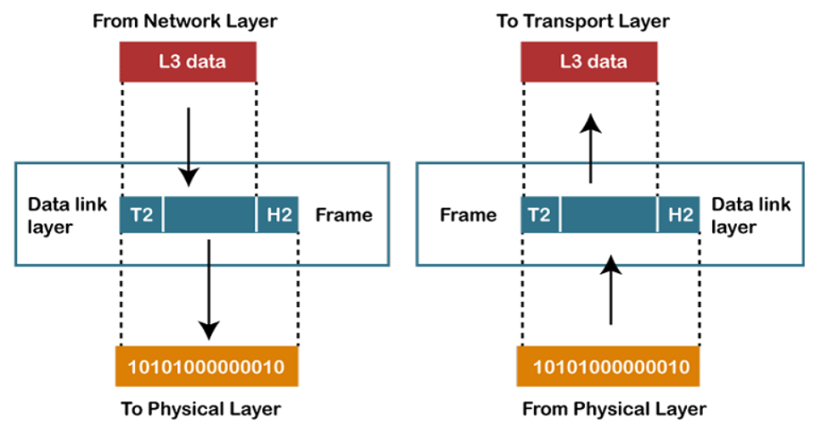
Data Link Layer
The data link layer is responsible for the node-to-node delivery of the message. The main function of this layer is to make sure data transfer is error-free from one node to another, over the physical layer. When a packet arrives in a network, it is the responsibility of the DLL to transmit it to the Host using its MAC address.

Slide 29
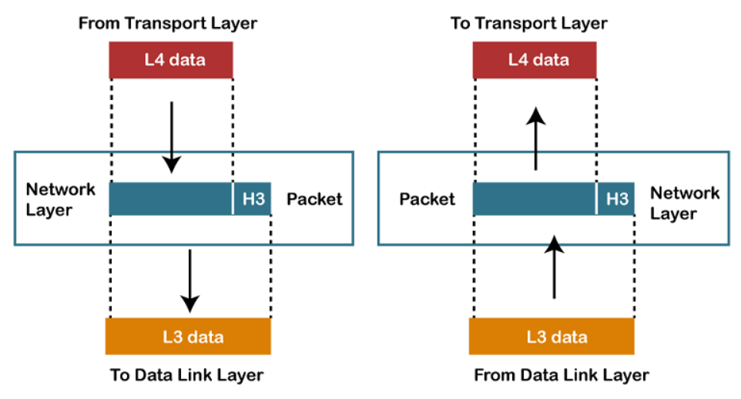
Network Layer
The network layer works for the transmission of data from one host to the other located in different networks. It also takes care of packet routing i.e. selection of the shortest path to transmit the packet, from the number of routes available. The sender & receiver’s IP address es are placed in the header by the network layer.
Segment in the Network layer is referred to as Packet .
Network layer is implemented by networking devices such as routers and switches.

Slide 30
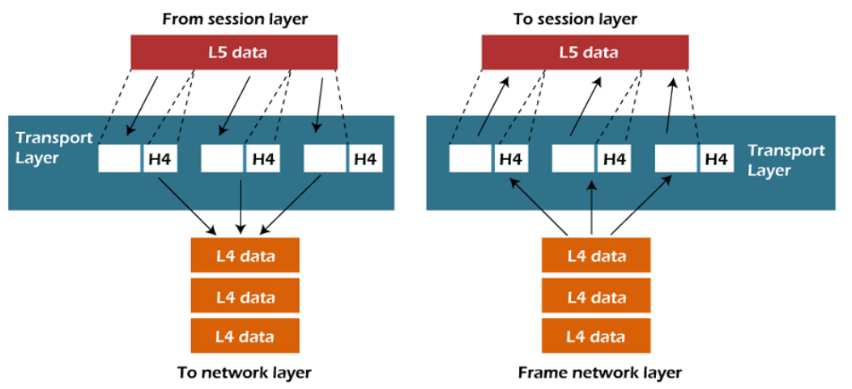
Transport Layer
The data in the transport layer is referred to as Segments . It is responsible for the end-to-end delivery of the complete message. The transport layer also provides the acknowledgment of the successful data transmission and re-transmits the data if an error is found.
Data in the Transport Layer is called Segments .
The transport layer is called as Heart of the OSI model.
Device or Protocol Use : TCP, UDP.

Slide 31
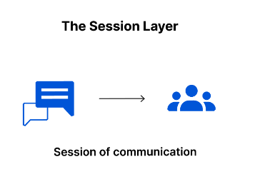
Session Layer
This is the layer responsible for opening and closing communication between the two devices. The time between when the communication is opened and closed is known as the session. The session layer ensures that the session stays open long enough to transfer all the data being exchanged, and then promptly closes the session in order to avoid wasting resources.

Slide 32
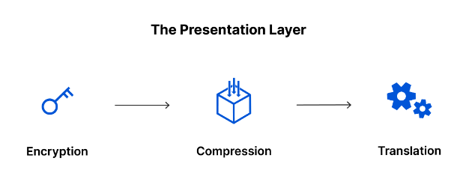
Presentation Layer
This layer is primarily responsible for preparing data so that it can be used by the application layer; in other words, layer 6 makes the data presentable for applications to consume. The presentation layer is responsible for translation, encryption, and compression of data.
Two communicating devices communicating may be using different encoding methods, so layer 6 is responsible for translating incoming data into a syntax that the application layer of the receiving device can understand.

Slide 33
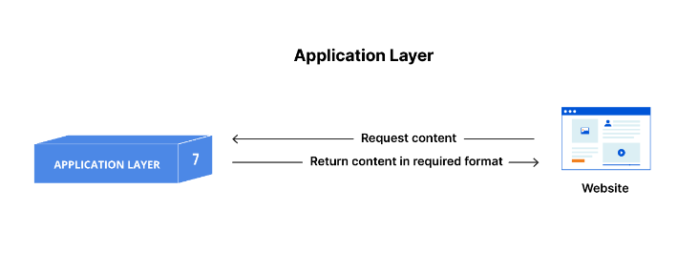
Application Layer
This is the top-most layer, closest to the end user. It provides the interface between the user's application and the underlying network. The Application layer enables user interaction with the network, allowing applications to access network services.
Examples of Protocols: HTTP (used by web browsers), FTP (File Transfer Protocol), SMTP (Simple Mail Transfer Protocol for email), DNS (Domain Name System).

